Slide 1
Image Background removal Service
By: Deepranjan Kumar Gupta

Slide 2
Why Image Background removal service ?
Background removal can be defined as a type of photo editing service that allows the editor to get rid of the unwanted background and replace it with another photograph or image that is appropriate as per the requirements of the customers or clients.
Image background removal services have now emerged as the most sought after photo editing service due to technological innovations in the field of photography and the way clients or customers would like to publicize their products and services as a brand.
The process of background removal seems to be easy but in reality it is complex in nature as it involves spending considerable time, technology and resources by the editors in getting the required picture or image as per the business requirements of the clients or users of the image or photographs.

Slide 3
MODNet: Moving Object Detection Network with Motion and Appearance for Autonomous Driving
MODNet is a light-weight matting objective decomposition network (MODNet), which can process portrait matting from a single input image in realtime.
MODNet is much faster than contemporaneous matting methods and runs at 63 frames per second.
MODNet achieves remarkable results in daily photos and videos.
MODNet is easy to be trained in an end-to-end style.
It is not an easy task to find the person and remove the background. Many techniques are using basic computer vision algorithms for this task quickly but not precisely.

Slide 4
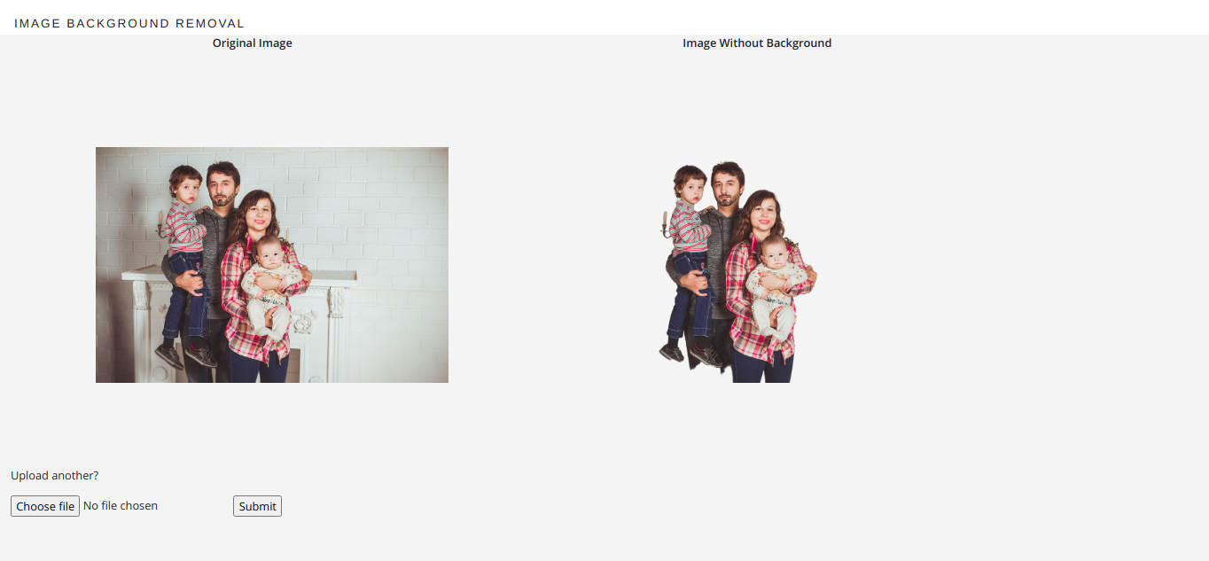
Screenshots

Slide 5
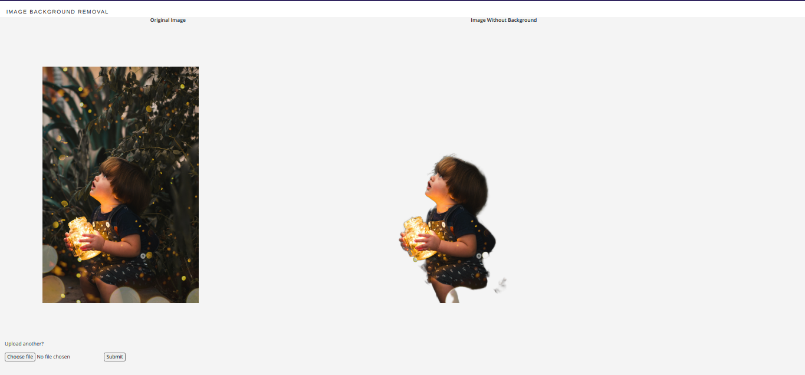

Slide 6
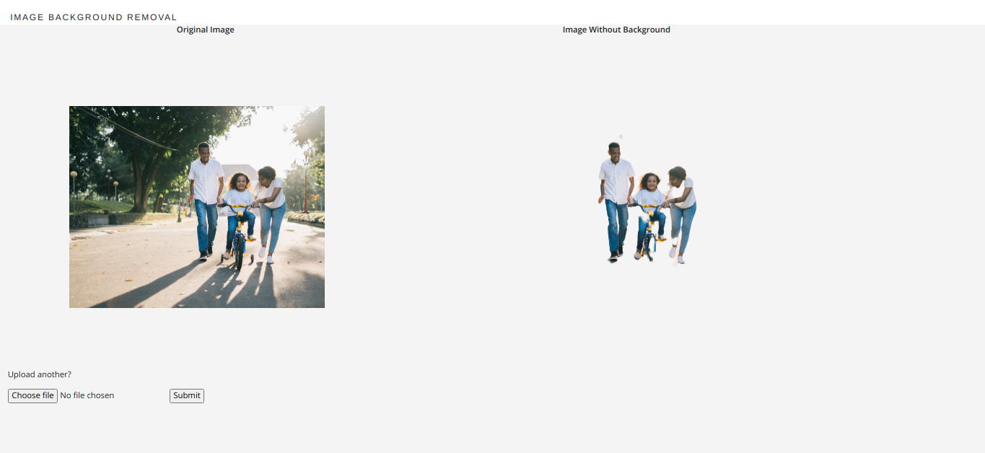

Slide 7
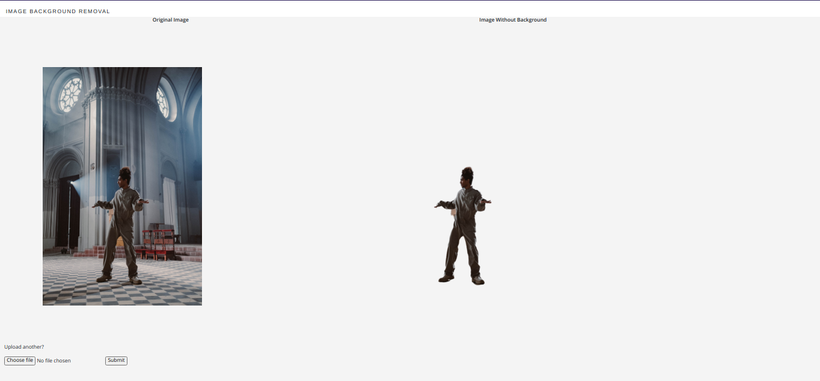

Slide 8
Github Link: https://github.com/DeepranjanG/Image_Background_Removal
Thank You

